Slide 1
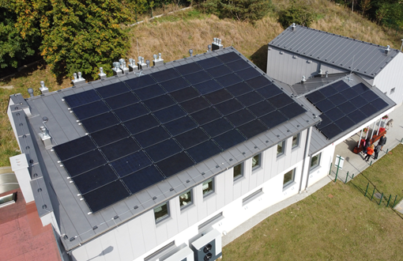
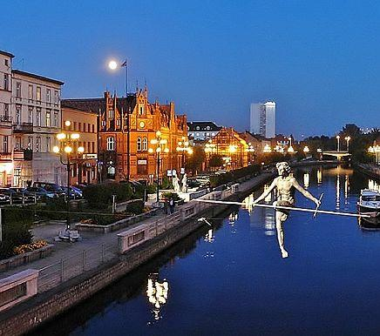
Bydgoszcz
The most successful projects in the field of energy and emission reduction:
Construction of a RES installation at the animal shelter in 2019.
Value: PLN 558,658.92 Co-financing: 85% of eligible costs
The building is equipped with photovoltaic installations and heat pumps. Goal: improve the efficiency of the heating unit system and to limit the purchase of electricity using RES through a 21 kW PV installation. The system is equipped with a battery set for storing electricity and an advanced energy management system (BMS).
The city's ambitions in the field of energy and emission reduction for the upcoming 10 years:
- a 40% reduction in CO2 emissions,
- achieving energy self-sufficiency of the municipality,
- increasing the production of RES to 200 GWh per year,
- thermal modernisation of public buildings, reduction of thermal energy consumption by 50%,
-replacement of city lighting with energy-efficient alternatives (32000 points); savings of 50%.

Slide 2
Cieszyn
The most successful projects in the field of energy and emission reduction:
Four stages of the project a.s.l.
Elimination of low emissions
- removal of individual solid-fuel-fired heat sources in 27 multi-family residential buildings,
- thermal modernisation of 27 multi-family residential buildings,
- co-financing from external resources of the WSL ROP, NFOŚiGW in the total amount of PLN 3.6 million,
- total value of the project PLN 7.7 million,
- annual reduction of CO2 emissions
- 967 [Mg], PM10 - 6.98 [Mg].
The city's ambitions in the field of energy and emission reduction for the upcoming 10 years:
The successive reduction of energy consumption and the reduction of pollutant emissions through energy efficiency measures and the use of renewable energy.

Slide 3
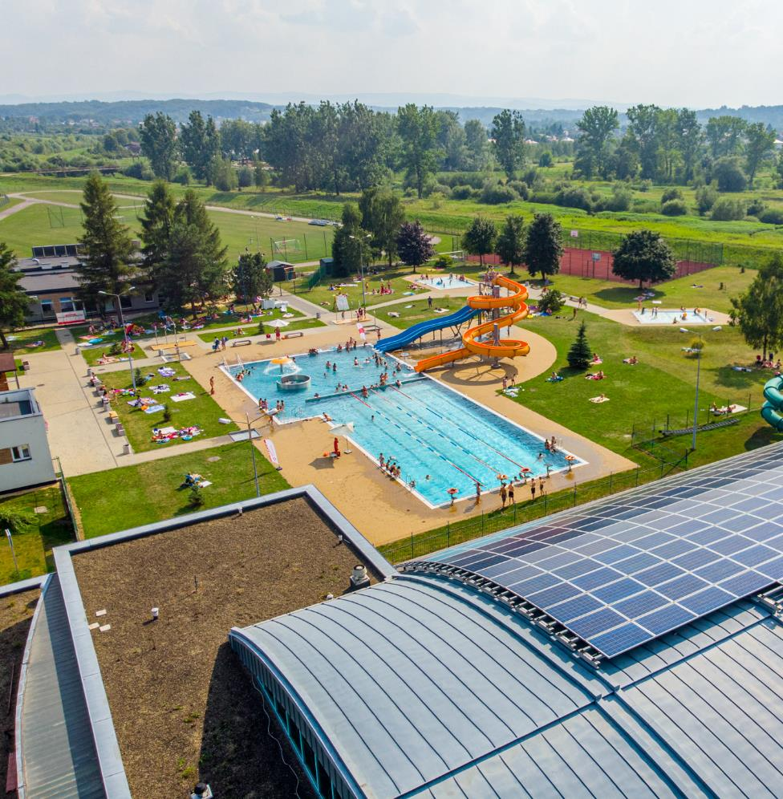
Jasło
The most successful projects in the field of energy and emission reduction:
"Installation of renewable energy systems on public buildings and private homes in Jasło City" - a project implemented under the Swiss programme for cooperation with the new Member States of the European Union.
The city's ambitions in the field of energy and emission reduction for the upcoming 10 years:
- the development of renewable energy installations;
- replacement of existing coal-fired boilers used by the population with gas-fired condensing boilers;
- construction of an independent cogeneration unit with the use of gas engines in MPGK Jasło;
- modernisation of street lighting - SOWA II.
The effect - reduction of greenhouse gas and dust emissions, reduction of energy consumption: electricity, heat and
reduced operating costs.

Slide 4
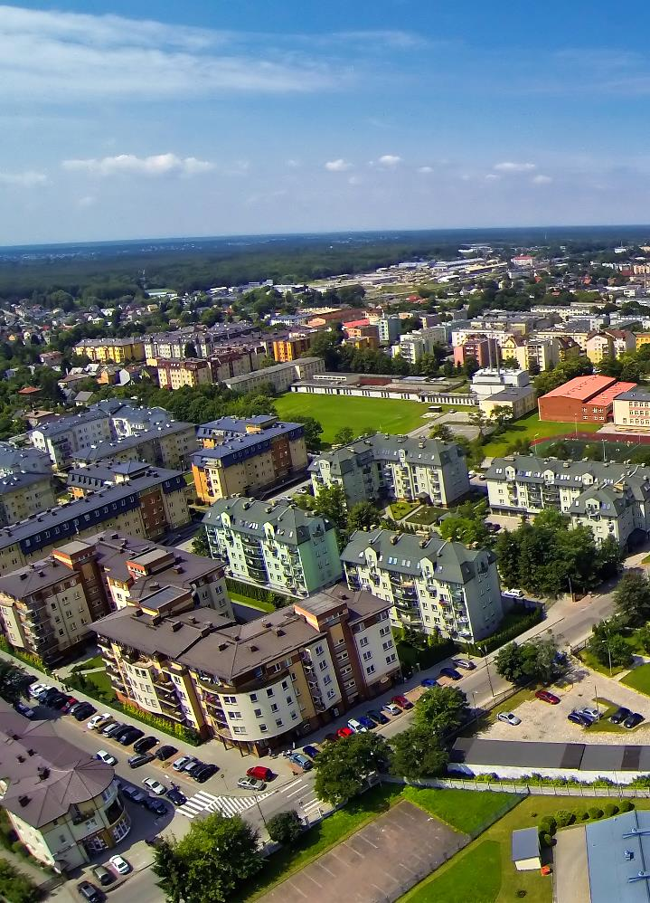
Mińsk Mazowiecki
The most successful projects in the field of energy
and emission reduction:
Construction of a combined heat and power unit (CHP):
- two identical, reciprocating gas engines,
- thermal power: 6.56 MW, electrical power: 6.41 MW,
- annual reduction in GHG emissions: 35 053 tonnes of CO2,
- primary energy consumption reduction 113 724 GJ/year
cost PLN 31,324,134.20.
Replacement of heating equipment - purchase of 54
gas boilers and 1 pellet boiler was subsidised,
- power of 1.17 MW (all installations)
- annual reduction in GHG emissions: 174 tonnes of CO2
- cost 765 139.65 PLN.
The city's ambitions in the field of energy and
emission reduction for the upcoming 10 years:
- installation of photovoltaic systems on buildings
of public utility belonging to the City,
- decommissioning of boilers fired with solid fuel,
- zero-emission public transport.
Zdjęcie miasta

Slide 5
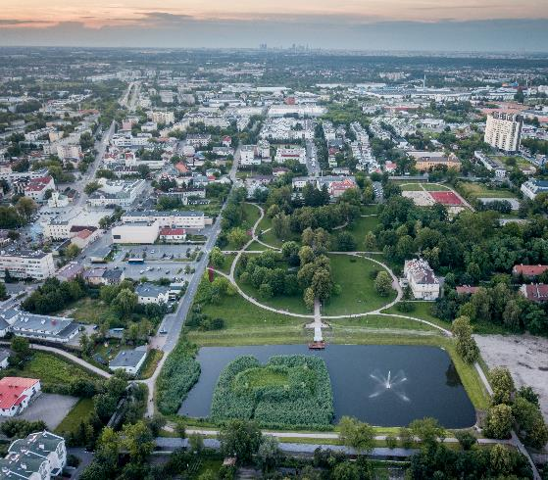
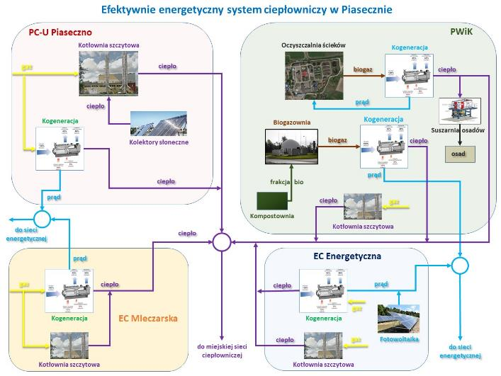
Piaseczno
The most successful projects in the field of energy
and emission reduction:
Energy management system in municipal facilities for the 2019/2020 heating season.
In 9 boiler rooms, devices for remote monitoring of heating installations and heat sources were installed. As a result, gas consumption in the heating season was reduced by 380 MWh.
The savings achieved were PLN 57,000 net on fuel and PLN 40,000 net on fixed charges for ordered power.
The city's ambitions in the field of energy and
emission reduction for the upcoming 10 years:
By 2030, construction of an energy complex consisting of several independent, sustainable energy sources together with the expansion of the heating network to connect new customers.
Goal: making Piaseczno independent from fossil fuels, complete removal of solid fuel furnaces in the city centre and reducing CO2 emissions.
In the complex, energy will be produced inter alia with heat pumps recovering heat from sewage, cogeneration on biogas obtained from the biogas plant for biodegradable waste and sewage sludge, and a biomass boiler. It is also planned to build a photovoltaic farm on a sewage treatment plant.
The result: reduction of CO2 emissions by 21 thousand tonnes per year
The cost of the whole project - about EUR 13 million

Slide 6
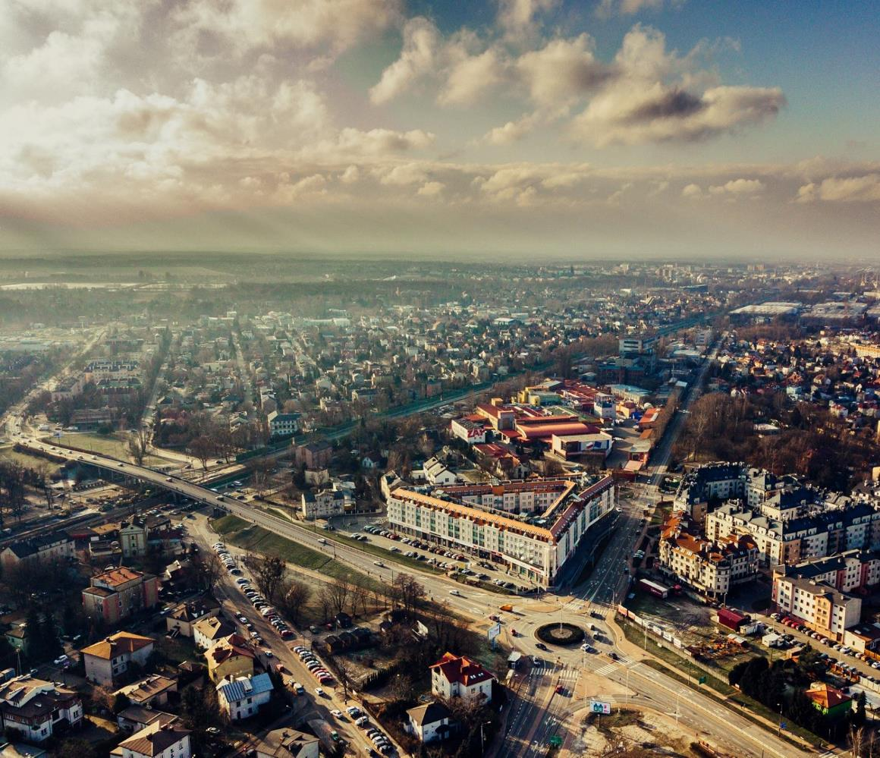
Piastów
The most successful projects in the field of energy
and emission reduction:
Thermo-modernisation of eight public buildings (4 schools, kindergarten, City Hall, MOK, municipal building)
Implementation: 2017-2018
Project value: 12 363 239.07 PLN (including co-financing 6 922 909.09 PLN)
Effects: additional capacity to produce energy from RES 41.3 kW,
6 constructed units of electricity generation from RES; energy saving 3 961 096.68 kWh/year; reduction of greenhouse gas emissions by 56.30%; usable area of buildings undergoing thermal modernisation 23 869.29 m2
The city's ambitions in the field of energy and
emission reduction for the upcoming 10 years: Implementation of the NewCity programme. Multifunctional Centre of the City as part of the Local Development programme in the field of RES development and energy self-sufficiency for the city.
Development and implementation of the city's climate change adaptation plan. Fulfilling the obligations resulting from the Covenant of Mayors for Climate and Energy.

Slide 7
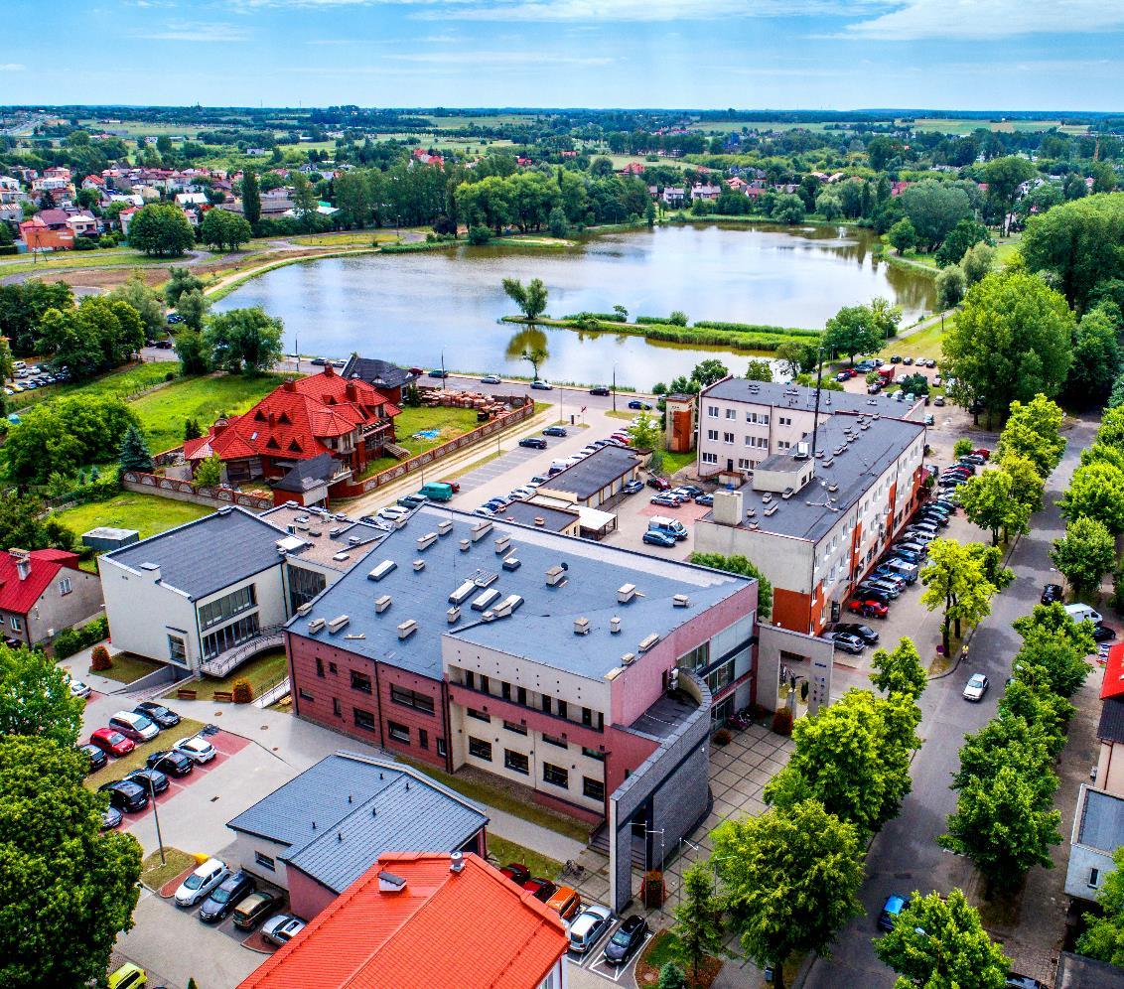
Płońsk
The most successful projects in the field of energy
and emission reduction:
Modernisation of the heating system in 2006-2007; 2015-2018; 2019-2020
In the years 2006 - 2019, the municipal company PEC obtained co-financing in the amount of PLN 45,626,700 from the EcoFund Foundation, NFOŚiGW and WFOŚiGW in Warsaw, of which PLN 16,772,975 is a subsidy, while PLN 28,853,725 is a subsidy in the form of preferential (partially redeemable) loans
- about 80% of the heat energy for the network comes from RES
- the company is one of the few in the country to have surplus CO2 emissions that it sells on European exchanges
- we also sell the property rights (green certificates) obtained for the production of "green energy"
The city's ambitions in the field of energy and
emission reduction for the upcoming 10 years:
- build a photovoltaic plant
- in the near future, production of heat and electricity from RDF fuel, which in Plonsk is separated in the waste separation plant.
It can produce about 150 thousand GJ of energy per year.
Herb miasta

Slide 8
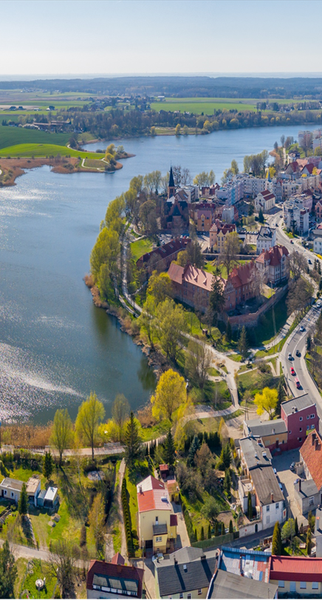
Sztum
The most successful projects in the field of energy
and emission reduction:
- "Renewable energy sources in the Municipality of Mikołajki Pomorskie and in the City and Municipality of Sztum"
- "Improving energy efficiency in the MOF Malbork - Sztum (street lighting) area" with the installation of a lighting control system.
A total of 208 RES installations were installed, including 1,641 in the area of the City and Commune of Sztum 127, and 2,771 lighting points were modernised.
Estimated total annual decrease in greenhouse gas emissions - 1,057.19 tonnes of eq. of CO2.
The city's ambitions in the field of energy and
emission reduction for the upcoming 10 years:
- a reduction in CO2 emissions of at least 40% by 2030 (Covenant of Mayors)

Slide 9
Zamość
The most successful projects in the field of energy
and emission reduction:
Thermal modernisation of public (educational) facilities
Total project value: 21 178 185.59 PLN; subsidy: 14 046 912.53 PLN
Between 2018 and 2020, thermal modernisation of 12 educational institutions.
Result: reduction of final energy demand by over 60%. Modernisation and replacement of heating systems, including heat pumps, resulted in a 50% reduction in CO2 and other greenhouse gas emissions
The city's ambitions in the field of energy and
emission reduction for the upcoming 10 years:
Striving to maintain zero-energy economic growth
Continuation of financial support for residents, aimed at eliminating inefficient heat sources
Increase the area of green areas by 10%
Reducing energy demand by 20% by saving energy and increasing energy efficiency (RES)
Reduce dependence on fossil fuels and increase the share of clean energy consumption by 20%
Reduce greenhouse gas emissions by at least 30%

