Slide 1
Debunking myths and countering climate misinformation in 2024: All Hands on Deck
Corina Murafa, Energy & Climate Policy Expert
20 February 2024

Slide 2
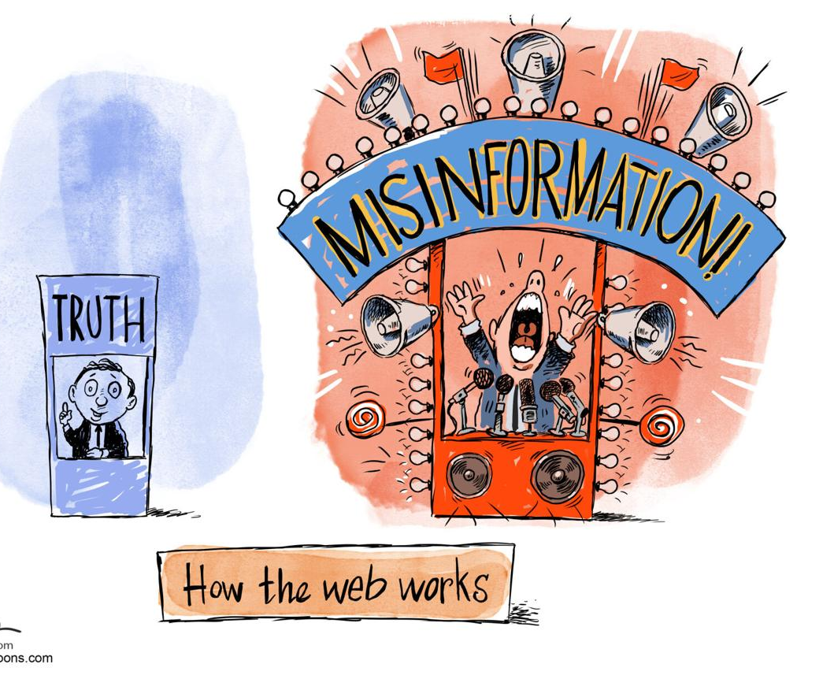
We live in the age of rampant misinformation
fake news spreads distinctively from real news even at early stages of propagation, e.g. five hours after the first re-postings
mainstreaming of the fringe and the marginalization of the mainstream
on Twitter, false news travels faster than true stories

Slide 3
What caused the farmers’ protests?

Slide 4
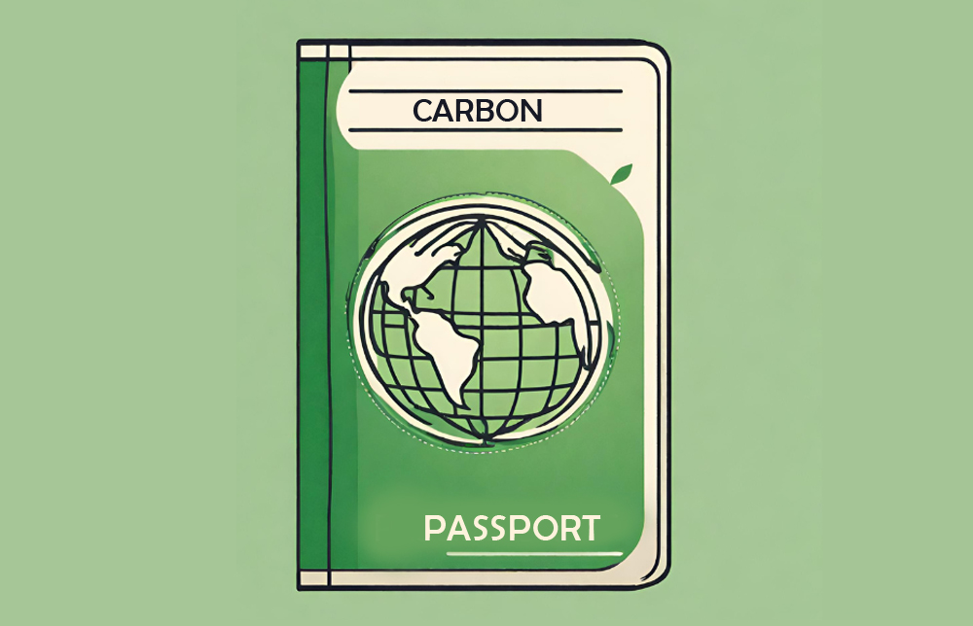
Myths I’ve heard lately #1 – The carbon passport
Truths
Yes, you can calculate your carbon footprint from travels
Yes, there is a Digital Product Passport
Yes, some Member States
Tax short flights
Ban short flights
Incentivize train travels

Slide 5
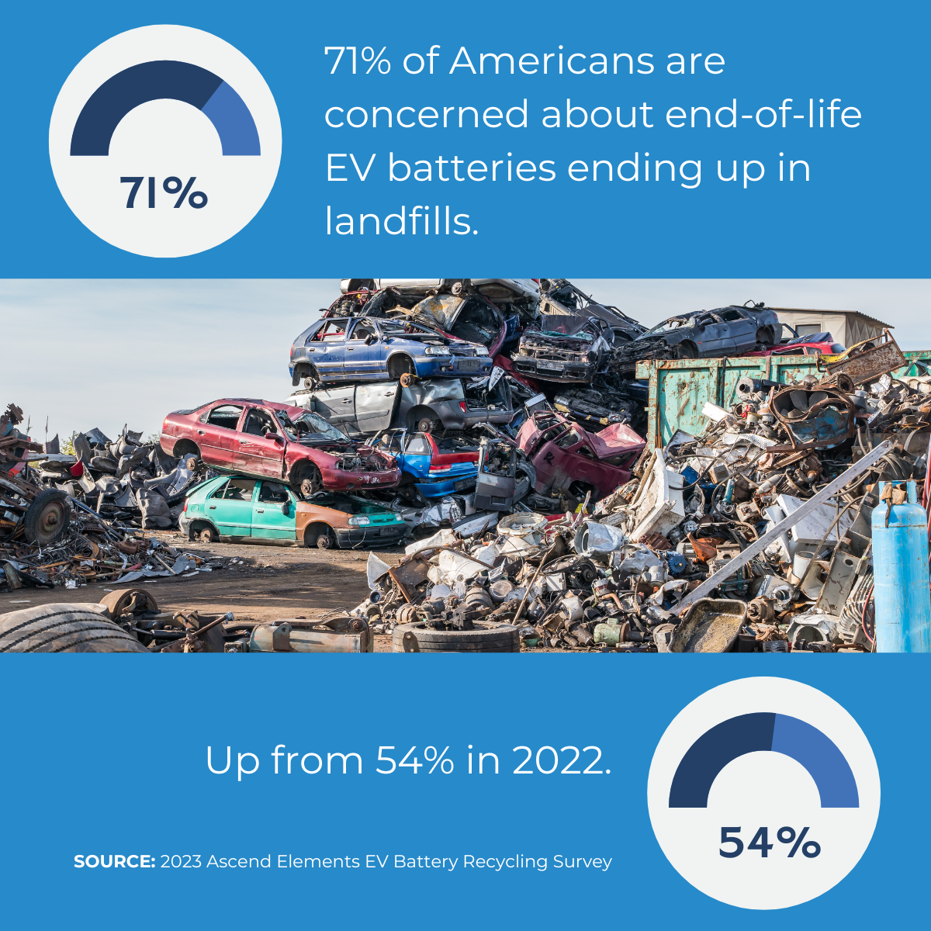
Myths I’ve heard lately #2 – The EV (car)pocalypse
more than 95 percent of rare metals inside EV batteries can be salvaged
Science evolves (Swedish researchers have developed a recycling method that allows recovery of 100 per cent of the aluminium and 98 per cent of the lithium in electric car batteries.)
total life-cycle emissions of hybrid and electric vehicles are reduced by up to 89 % compared to internal combustion engine vehicles

Slide 6
As a result, the air is heavy in Brussels…

Slide 7
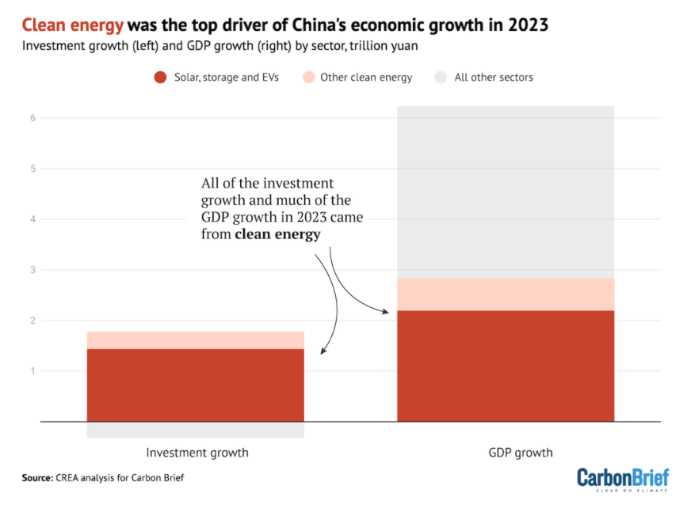
BUT, inaction is more costly than action
Global economic losses due to climate change (2023) – USD 120 billion, out of which 60% uninsured (SwissRE)
3.2 degrees scenario => 18% GDP loss
The green economy is driving the global race to the bottom top

Slide 8
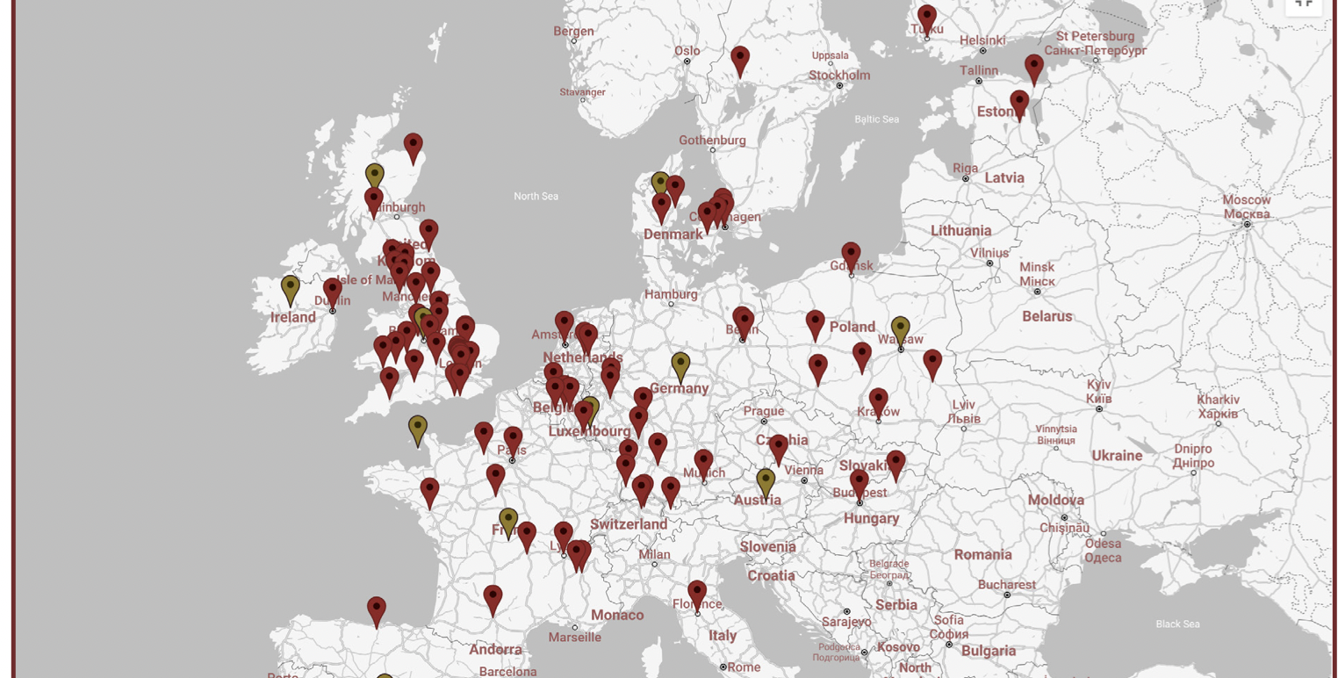
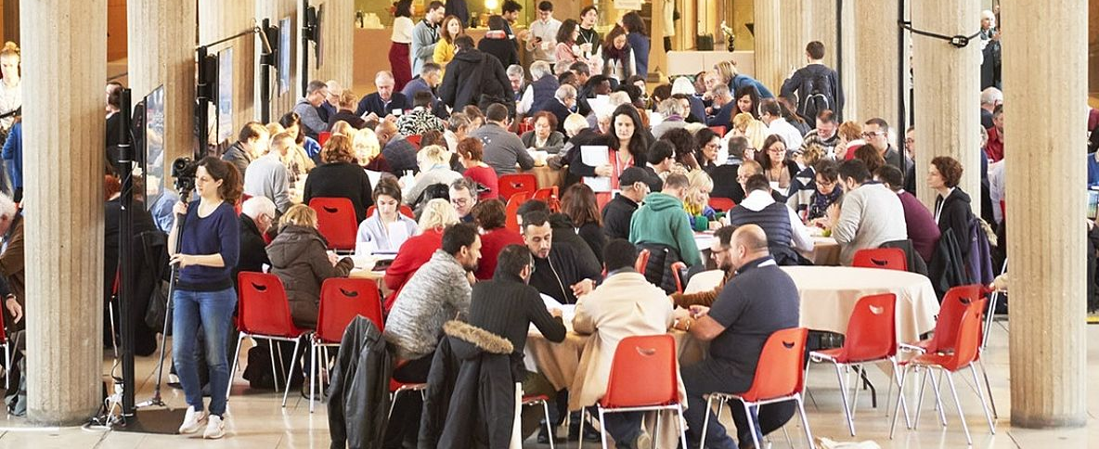
Idea #1 for a Mayor: A Climate Assembly
A “deliberative wave” of citizens’ assemblies - Global, national, local, from Brazil to Skopje (details here).
Taking part in Climate Assembly UK had a big impact on both the climate views and actions of assembly members, and possibly their political attitudes and actions.
Check out Knowledge Network on Climate Assemblies.

Slide 9
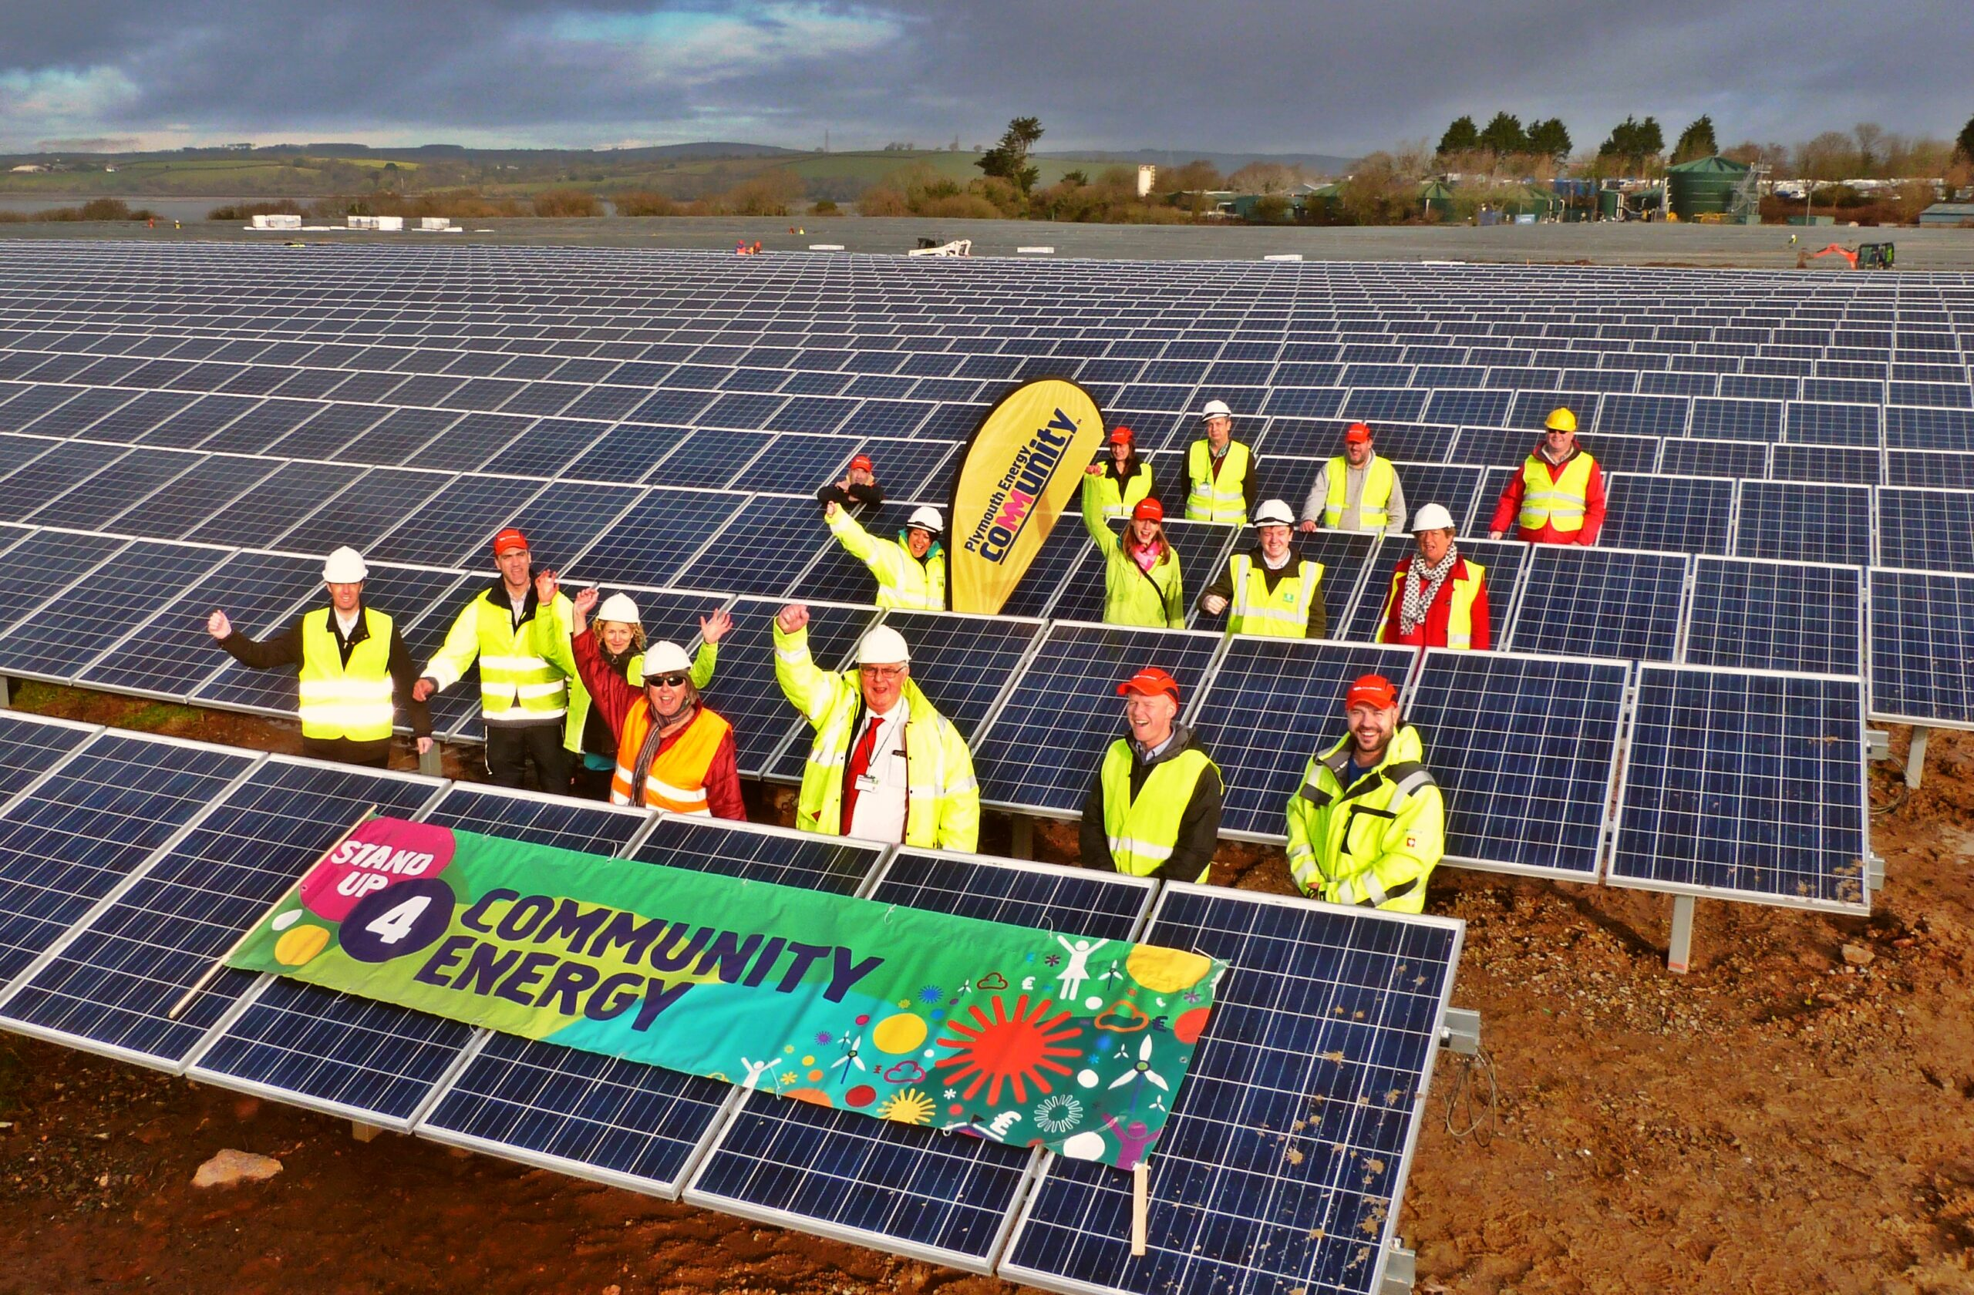
Idea #2 for a Mayor: An Energy Community
4% of EU citizens involved in 9000 energy communities
Revenues 2 to 8 times higher for local communities than conventional RES
Fostering democracy, trust, cooperation

Slide 10
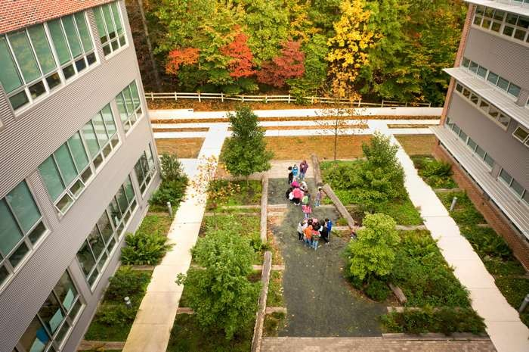
Idea #3 for a Mayor: Green schools
Green schools (evidence: environmental quality and young people’s well-being are inextricably linked + improved attainment, results, focus on other topics)
Programmes for climate education in schools
Green weeks

